Slide 1
19Z203 - INDUSTRIAL ELECTROCHEMISTRY
CO1 – ELECTROCHEMISTRY
CO2 – COROSSION
CO3 – METAL FINISHING IN ELECTRONIC INDUSTRY
CO4 – ELECTROCHEMICAL POWER SOURCES
CO5 - SENSORS

Slide 2
COURSE OUTCOMES
After completion of the course students should be able to:
CO1: Understand the working principles of electrochemical cells. CO2: Recognize the different forms of corrosion and suggest suitable corrosion control methods. CO3: Discuss the diverse roles of electrochemical processes in industries. CO4: Describe the chemistry of electrochemical power sources.
CO5: Comprehend the working principles of electrochemical sensors.

Slide 3
ELECTROCHEMISTRY: Conductance of strong and weak electrolytes, mobility of ions - transport number, applications of conductance measurement. Electrode potential – standard and reference electrodes, Nernst equation, emf series – applications. Galvanic and concentration cells. Applications of emf measurements – glass electrode - pH measurement, potentiometric- redox titrations.
CORROSION: Mechanisms - Galvanic and differential aeration corrosion. Corrosion rate – factors influencing corrosion - galvanic series. Corrosion control - corrosion inhibitors, cathodic protection - sacrificial anode, current impression, conversion coatings – anodizing – determination of thickness of anodized film. Nature inspired coatings-superhydrophobic coatings, self healing coatings. Corrosion in electronic components – control by vapour phase inhibitors.
METAL FINISHING IN ELECTRONIC INDUSTRY: Electroplating – plating parameters- polarization and overvoltage, current and energy efficiency. Electroplating of Cu, Ni, and Cr. Electroless deposition of Ni and Cu. Production of plated through hole PCBs, electroforming - fabrication of CD stampers, electrochemical etching of Cu from PCBs , Electrophoretic painting, Electrochemical etching of semiconductors.
ELECTROCHEMICAL POWER SOURCES: Batteries- types, characteristics. Fabrication and working of lechlanche cell, primary lithium cell, lead- acid battery, Ni-metal hydride and lithium ion batteries. Supercapacitors. Fuel cells - Classification, working principle, components, applications of proton exchange membrane, direct methanol and solid oxide fuel cells. Hydrogen as a fuel-production and storage.
SENSORS: Components of electrochemical sensors, electrochemical transducers-potentiometric, amperometric and conductometric methods – ion-selective electrodes – solid-state electrode, liquid ion-exchange membrane electrodes. Gas sensors – CO2, O2 and NH3 sensing. Sensors for health care – glucose and urea.

Slide 4
Text Books:
1. Derek Pletcher and Frank C. Walsh. Industrial Electrochemistry 2nd Edition London: Chapman and Hall , 1993.
2. John O’M.Bockris and Amulya K. N. Reddy. Modern Electrochemistry 2B 2nd Edition New York: Kluwer Academic/Plenum Publishers , 1998.
Reference :
1. Dell R. M. and Rand D. A. J. Understanding Batteries 1st Edition UK: Royal Society of Chemistry , 2001.
2. Brian Eggins. Chemical Sensors and Biosensors 1st Edition US: John Willey & Sons , 2002.
3. Zaki Ahmad, Digby Macdonald. Principles of Corrosion Engineering and Corrosion Control 2nd Edition London: Butterworth-Heinemann , 2013.
4. Shashi Chawla. A Textbook of Engineering Chemistry 1st Edition New Delhi: Dhanpat Rai and Co. , 2005.

Slide 5
ELECTROCHEMISTRY Electrolytic conductance : specific conductance & Molar conductance Strong and weak electrolytes Factors influencing conductance Temperature dilution Mobility of ions- transport number Applications of conductance measurement Conductometric titrations Acid- base titrations
Electrochemical cells: Galvanic cells EMF Electrode potential –electrical double layer Types of electrodes metal – metal ion, redo electrodes, reference electrodes – gas electrodes -SHE, metal – metal salt ion electrodes - SCE, Ag/AgCl/KCl Standard electrode potential – emf series- applications
Variation of EMF and electrode potential with concentration of electrolytes – Nernst equation – derivation, numerical problems – calculation of Ecell, ΔG, K. Concentration cells – types – electrolyte concentration cells – EMF expression. Applications of emf measurement pH measurement – glass electrode potentiometric redox titration.

Slide 6
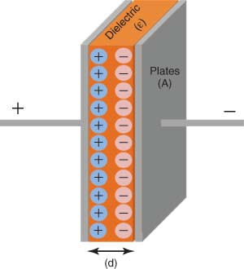
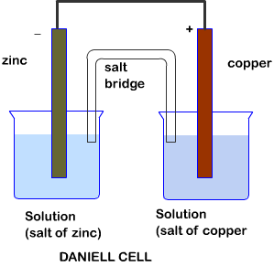
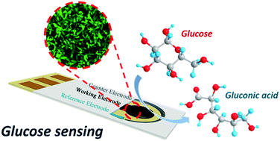
Electrochemistry
Study of science which deals with the conversion of chemical energy into electrical energy. The chemical energy is provided by redox reactions.

Slide 7
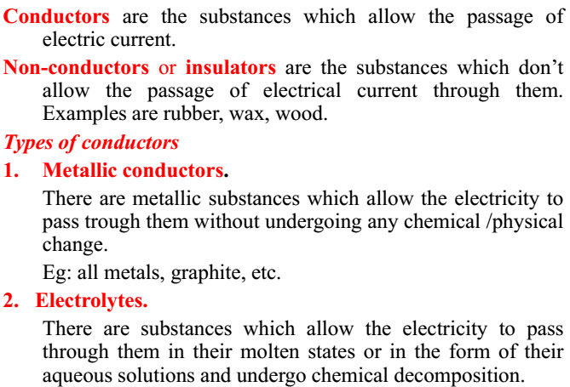

Slide 8
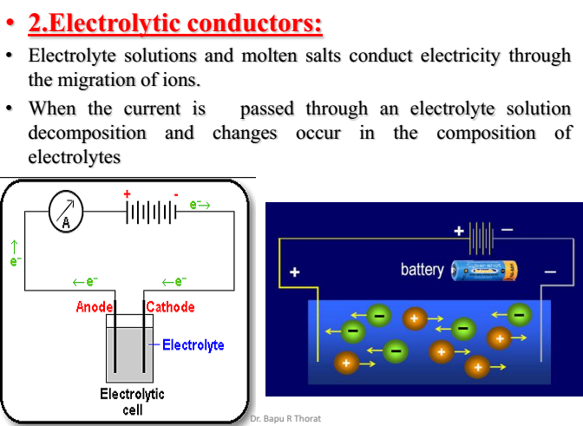

Slide 9
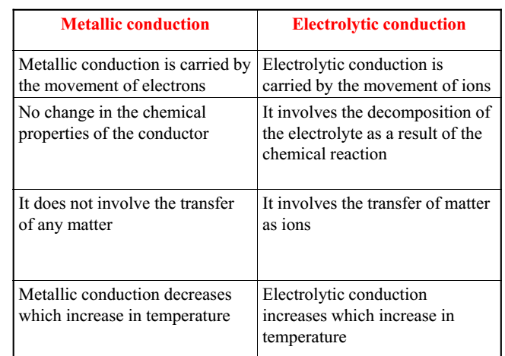

Slide 10
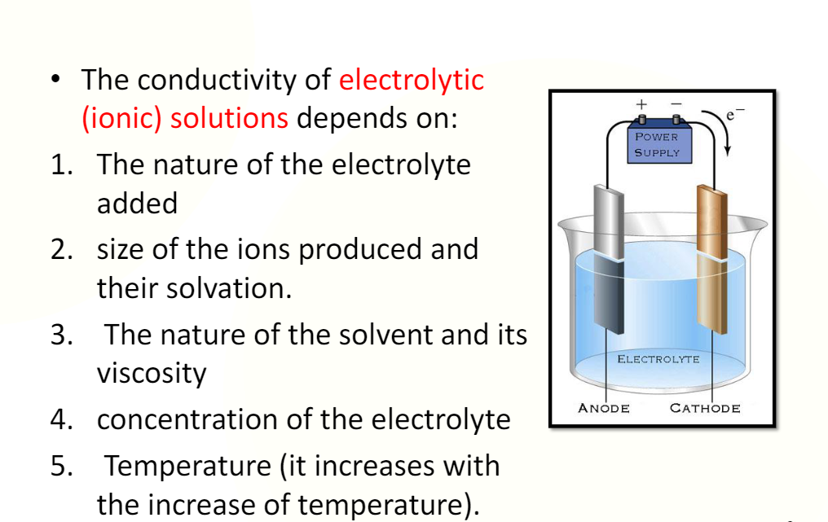

Slide 11
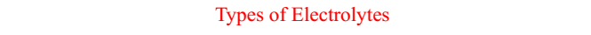
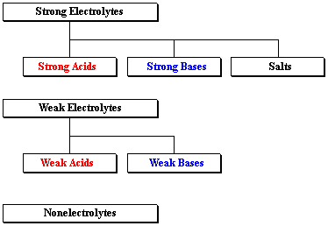

Slide 12
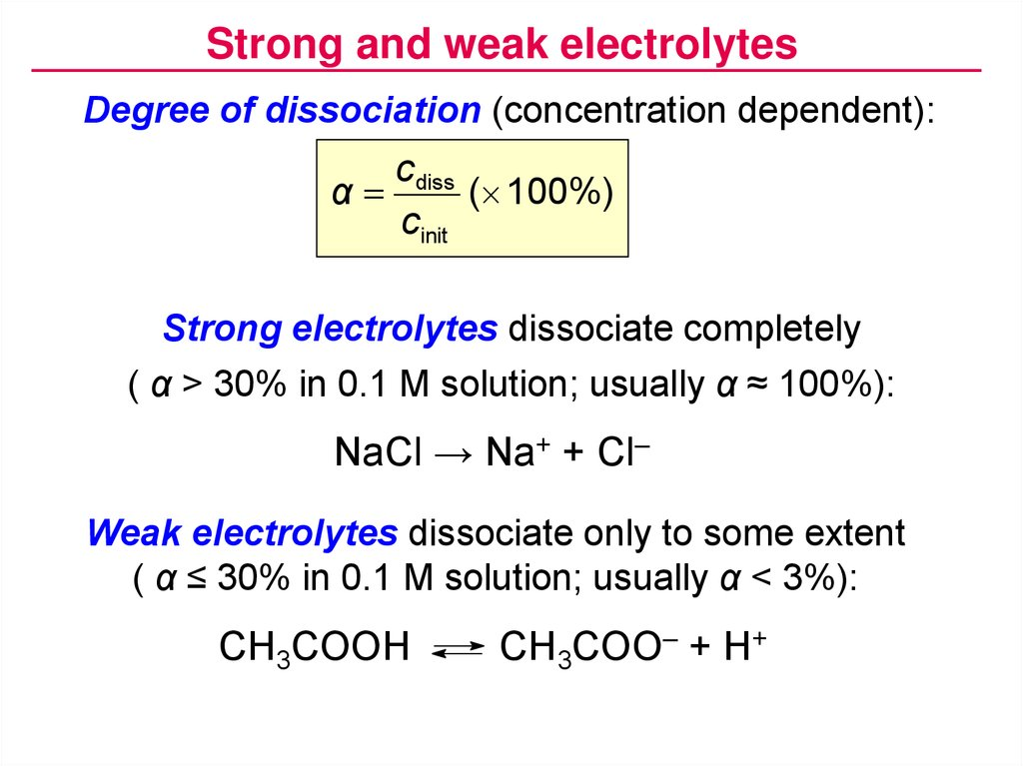

Slide 13
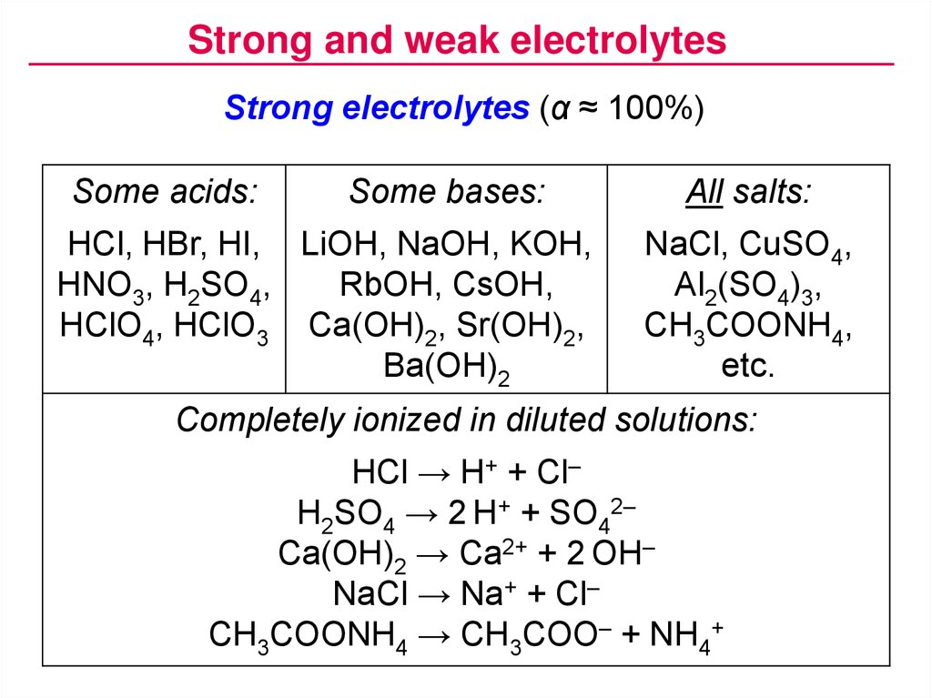

Slide 14
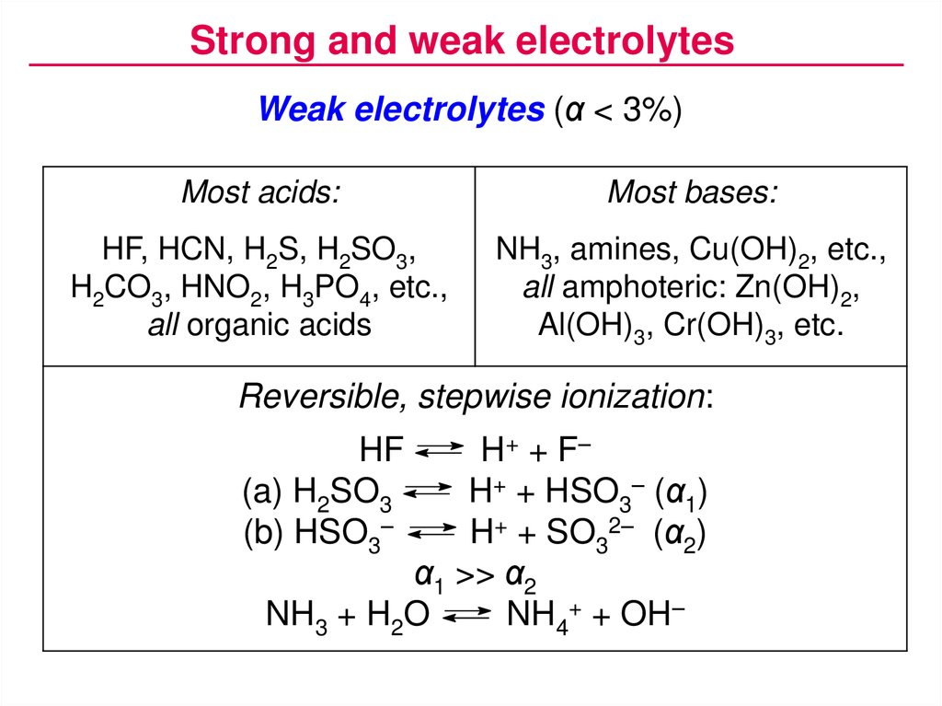

Slide 15
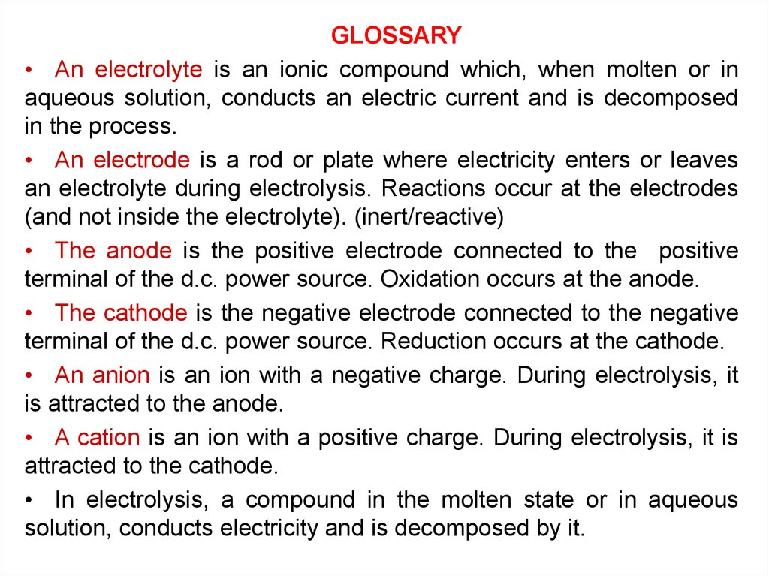

Slide 16
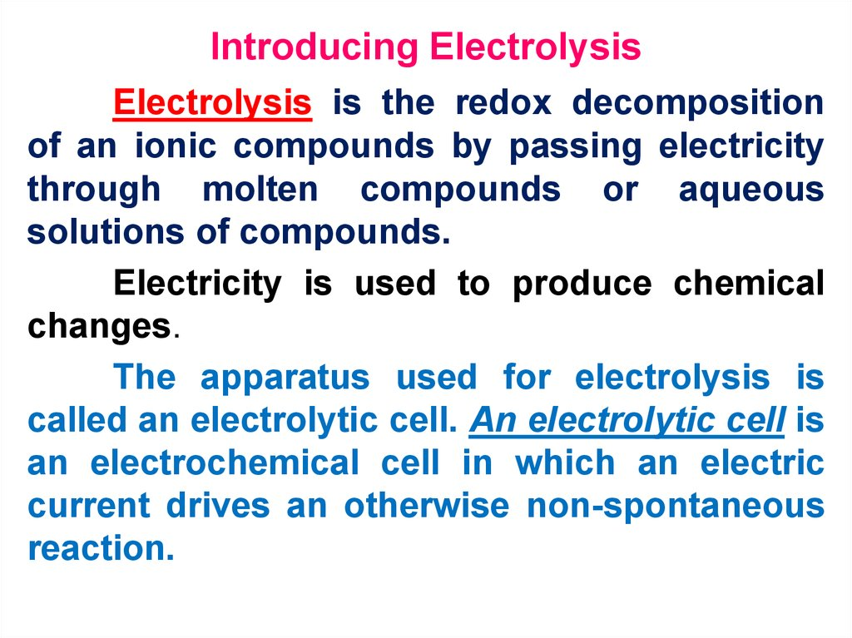

Slide 17
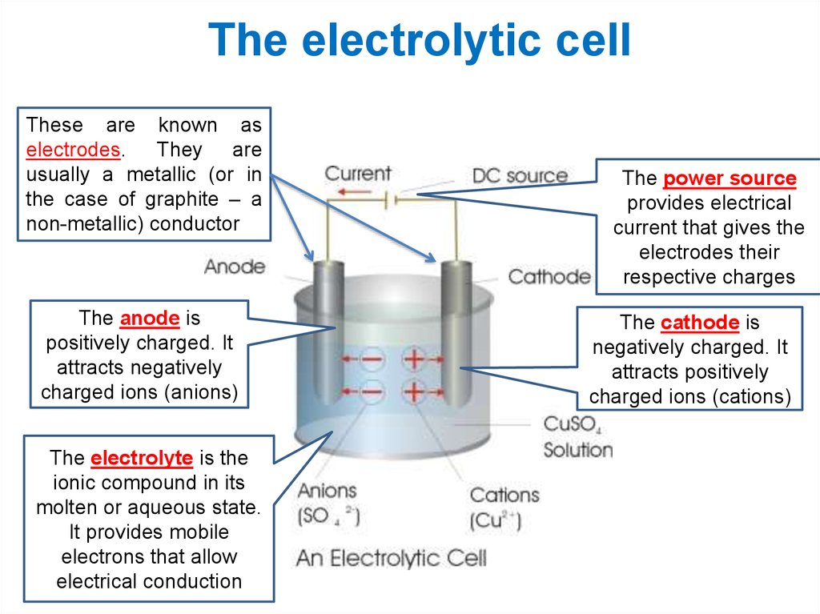
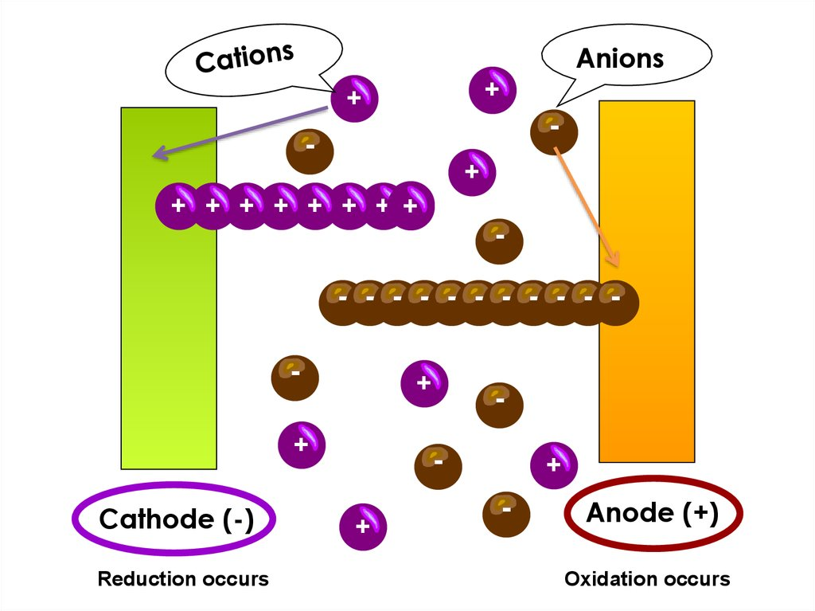

Slide 18
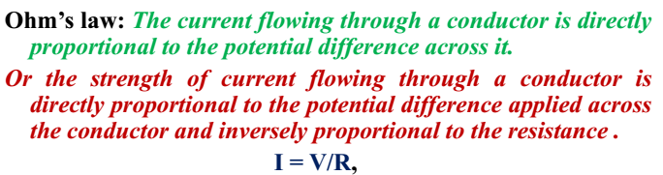
Some basics……
I = Current (in Ampere)
V = Potential difference applied between the conductors (in Volt)
R = Resistance offered by the conductor (ohm)

Slide 19
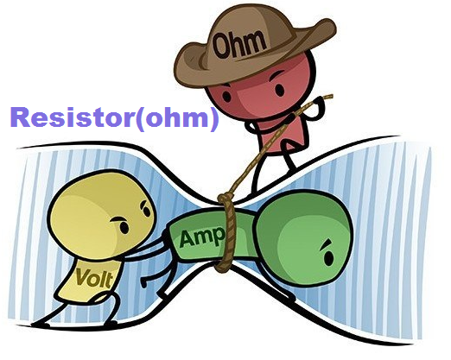
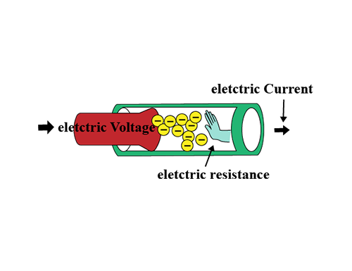
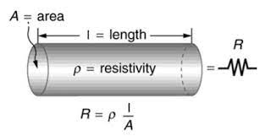
Resistance
Resistance is the hindrance to the flow of electrons in material. While a potential difference across the conductor encourages the flow of electrons, resistance discourages it. The basic unit of electrical resistance is the Ohm (Ω).
For a conductor of uniform cross sectional area (A) and length (l), Resistance (R) is given by

Slide 20
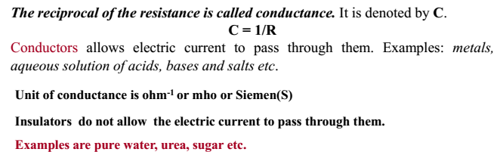
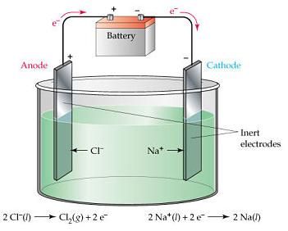
Conductance
Specific Conductance
Equivalent Conductance
Molar Conductance

Slide 21
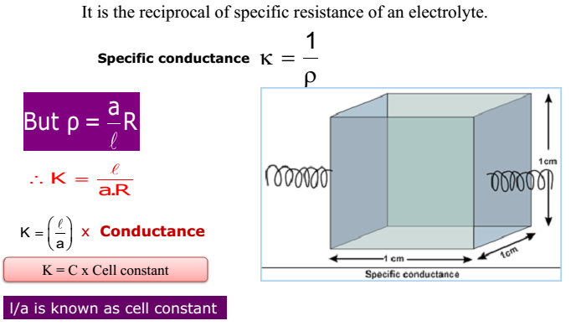
Specific Conductance
Specific conductance is the reciprocal of specific resistance.
Definition: Conducting capacity of a solution of dissolved electrolyte and the whole solution is placed between two electrodes with area 1 cm² and length 1 cm
Unit for Specific Conductance is ohm⁻¹ cm⁻¹
SI unit is Siemens m⁻¹ or S m⁻¹

Slide 22
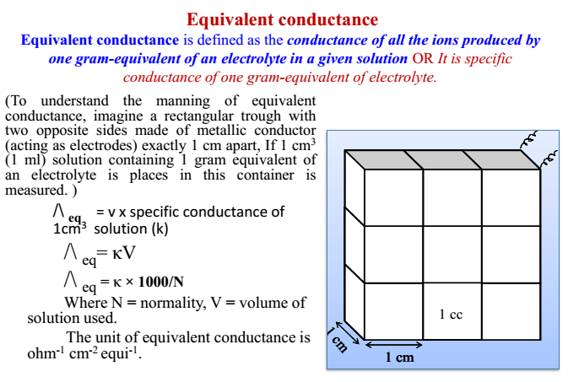
Equivalent Conductance

Slide 23
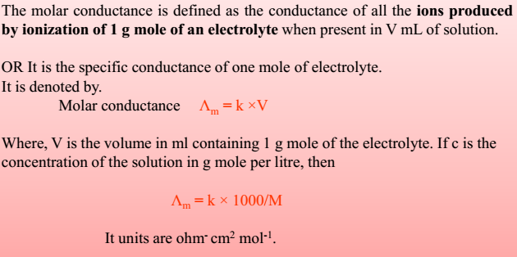
Molar Conductance

Slide 24
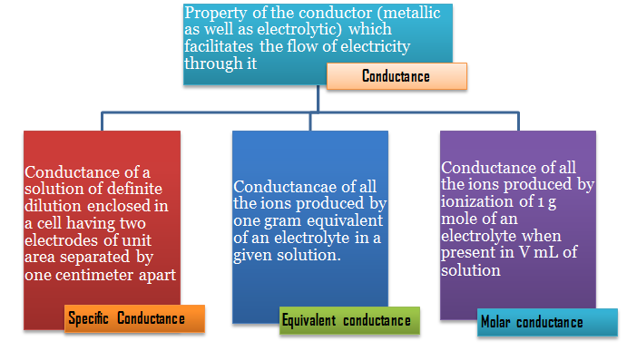
Conductance

Slide 25
Ionic Conductance

